Slide 1
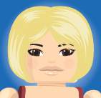




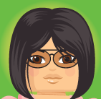

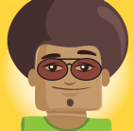


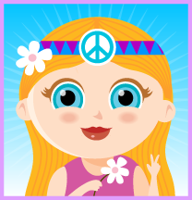

Welcome to COMU7311 Intercultural Communication
Shuang Liu
School of Communication and Arts
UQ, Sem 1 2021

Slide 2
Course Coordinator/Lecturer
Shuang Liu (Shuang)
Email: shuang.liu@uq.edu.au
Phone: 3346 8242
Office location: Room 712, Michie Building, St Lucia campus
Consultation hours: Monday 10am-12pm during teaching weeks OR by appointment.

Slide 3

Tutors and contact information
Shuang Liu (Shuang)
Tutorial group: FD/T02
Email: shuang.liu@uq.edu.au
Sushma Griffin (Sushma)
Tutorial groups: FD/T01, EX/T01, EX/T04
Email: sushma.griffin@uq.edu.au
Tran Nghi Le Tran (Tran)
Tutorial groups: EX/T02, EX/T03
Email: n.tranle@uq.edu.au
Note: Consultation with tutors is by appointment.

Slide 4
Learning objectives
At the end of this lecture, you should be able to:
Have a good understanding of the course structure and requirements.
Recognise the importance of knowledge of intercultural communication.

Slide 5
What ability will I develop in this course?
Demonstrated knowledge and skills of intercultural communication.
Critical analysis of the role of communication in various situations.
Ability to translate knowledge and skills to specialist and non-specialist audiences.
Engaging sensitively, confidently, and appropriately in intercultural communication.
Capacity to train yourself and others to become competent communicators in intercultural contexts.

Slide 6

What learning resources do I have?
Blackboard course site
Electronic Course Profile (ECP)
Lectures and tutorials; lecture notes, power point slides, tutorial notes, and readings, and Q&A Padlet
Discussion board on Blackboard
Consultation
Peer learning support

Slide 7

What should I do to learn in the course?
Read lecture notes, powerpoints, and required reading prior to each lecture.
Read tutorial notes prior to each tutorial.
Participate in exercises in class or online.
Check your UQ STUDENT email account regularly.
Submit your assignments by the due date.

Slide 8
Course structure
Knowledge & Skills | Globalisation, culture and people, media and culture, communication, Individual and collective identities | Weeks 1-5
Application of knowledge and skills | Building intercultural relations Managing intercultural conflicts Living with cultural others Managing diversity at workplaces Managing intergenerational relations Training intercultural competence | Week 6-12
Review and self-directed learning | Reviewing learning materials, and working on the final assignment. | Week 13

Slide 9
What are the assessments in this course?
Assessment item | Due date | Weighting
My culture and my people | 17 March 2021, 16:00 1000 words | 15%
My intercultural experience | 28 April 2021, 16:00 2000 words | 40%
Intercultural training program | 7 June 2021, 16:00 2000 words | 45%
All three assignments should be submitted via Turnitin.

Slide 10
How will my assignment be assessed?
Each assessment item will be marked by the marking criteria, available on Blackboard and in the ECP.
Your final grade in this course will be calculated based on the cumulative marks you have obtained for each of the three assessment items.
You must submit each assessment item to be eligible for receiving a passing grade in the course (see ECP Section 5.2).
Your assignments are assessed based on the marking criteria in this course, NOT assessed with reference to the grades of other students or your performance in other courses.

Slide 11
Extensions
Extensions requests are due before the assessment deadline. Application received after the deadline will not be accepted unless there is evidence of extenuating circumstances (see ECP 5.3).
Penalties apply for late submissions without approved extensions (see ECP Section 5.3).
Please refer to the “Apply for an extension” page on my.UQ for acceptable reasons for an extension and for instructions on how to apply.

Slide 12
Re-marking
What if you are not satisfied with the grade given to your
assignment?
Read the feedback on the assignment.
Contact your course coordinator or tutor for further feedback, explain why you disagree with the mark given.
If an agreement is not reached and you have a legitimate reason to request for an assessment re-mark, please refer to ECP 5.4 for information on the process for submitting an application.

Slide 13
Academic integrity and plagiarism
Academic Integrity
Students have a responsibility to maintain the highest standards of academic integrity in their work. Students must not cheat in examinations or other forms of assessment and must ensure they do not plagiarise.
Plagiarism
The University has adopted the following definition of plagiarism:
Plagiarism is the act of misrepresenting as one's own original work the ideas, interpretations, words or creative works of another. These include published and unpublished documents, designs, music, sounds, images, photographs, computer codes and ideas gained through working in a group. These ideas, interpretations, words or works may be found in print and/or electronic media.
Read the UQ Student Integrity and Misconduct policy. http://ppl.app.uq.edu.au/content/3.60.04-student-integrity-and-misconduct

Slide 14

I welcome your feedback on the course!
I always welcome your feedback and suggestions on the teaching and learning in this course throughout the semester!

Slide 15
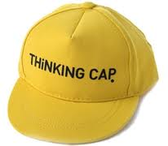
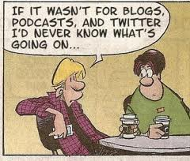
Thinking cap on…
Do we partake of a more unified or diversified world because communication technologies bring us closer?

Slide 16
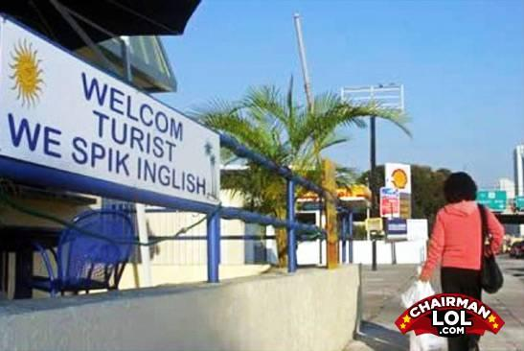
Unity vs diversity
In what ways has our world become more unified?
In what ways has our world become more diversified?

Slide 17
Relating to the required reading this week
The reading reported findings from interviews with English-speaking educators who teach in international schools overseas – their personal struggles of interacting as ‘the other’, and inability to integrate.
Does contact between cultures and nations make us more global or more local in cultural identification? Why?

Slide 18
Your cultural collage… …
Your cultural collage visually tells others who you are – your identities. It identifies you as an individual as well as a member of a group (or groups) you belong to.
Think about your cultural collage now. This will help you to see how you see things through your cultural lenses, and get you prepared for your first assignment.

Slide 19
Next week…
Next week’s lecture will focus on culture; we will discuss the nature and characteristics of culture, and how it influences our thinking, doing, and being.
Tutorials start in Week 2. Share your cultural collage with your classmates in class.

